Slide 1
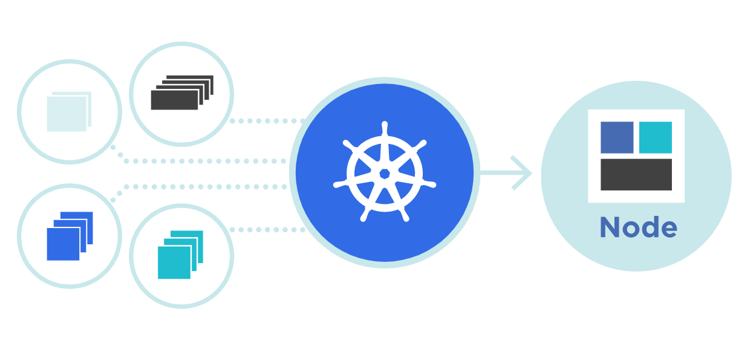



NameSpace
Theory + LAB + Documents ➔ All free
WATCH NOW
Notes:
Hello everyone. My name is Anish Rana and you are watching Kubernetes web series.
If you are new to this channel and wish to learn Kubernetes from the scratch, then you may click on the I button at top right-hand side for the Kubernetes playlist.
I added the Kubernetes playlist URL in the description.
Just for your information, this power point document can be downloaded from my Github page. Besides this, subtitle for different languages, such as English, French, Russian and German, are available for this video.
Today, we're going to cover one interesting topic, i.e. “What is NameSpace?"

Slide 2
Agenda of this video.
Understanding of Namespace.
What is NameSpace?
Initial namespaces.
Where we can use the Namespaces.
How to create the namespace?
How to add Quota with Namespace?
LAB

Slide 3
01 NOW WE WILL TALK ABOUT
Understanding of Namespace

Slide 4






Master
Worker1
Worker2
Read & Write
Read & Write
Read Only
Development Team
Operation Team
They would also like to maintain a space in the cluster.
In this space, some people has full access, and some engineers has only read access.
They would like to maintain a space in the cluster.
In this space, they want full access to all their team members.

Slide 5

Development
20 GB HD
320 GB Hard Disk
32 CPU
128 GB RAM
2 GB RAM
2 CPU
Operation
POD
10 GB HD
2 GB RAM
POD
2 CPU
2 CPU

Slide 6
02 NOW WE WILL TALK ABOUT
What is Namespace?

Slide 7
In Kubernetes, namespaces provides a mechanism for isolating groups of resources within a single cluster.
Names of resources need to be unique within a namespace, but not across namespaces.
Namespace is a Virtual Cluster, that’s used to make it easier for larges teams to work.
Namespace-based scoping is applicable only for namespaced objects (e.g. Deployments, Services, etc) and not for cluster-wide objects (e.g. StorageClass, Nodes, PersistentVolumes, etc).

Slide 8
03 NOW WE WILL TALK ABOUT
Initial namespaces

Slide 9
[root@master1 ~]# kubectl get namespaces Or kubectl get ns
NAME STATUS AGE
default Active 34d
kube-node-lease Active 34d
kube-public Active 34d
kube-system Active 34d

Slide 10
kube-system:
Kubernetes system create the objects under this namespace.
default:
One can start using your new cluster without creating a namespace.
kube-node-lease:
This namespace holds Lease objects associated with each node. Node leases allow the kubelet to send heartbeats so that the control plane can detect node failure.
kube-public:
This namespace is readable by all clients (including those not authenticated). This namespace is mostly reserved for cluster usage, in case that some resources should be visible and readable publicly throughout the whole cluster. The public aspect of this namespace is only a convention, not a requirement.

Slide 11
04 NOW WE WILL TALK ABOUT
Where we can use the Namespaces.

Slide 12







Grouping of resources.
Kubernetes Cluster
Monitoring
Database
Loadbalancer

Slide 13





When we have multiple teams
Kubernetes Cluster
Development Team
Testing Team
Production Team

Slide 14
When we have 3P and production in the same cluster.
Kubernetes Cluster
Pre-Production Platform
Production Platform

Slide 15
05 NOW WE WILL TALK ABOUT
How to create Namespace?

Slide 16
From Yaml file:
From Command Line:
kubectl create ns operation
apiVersion: v1
kind: Namespace
metadata:
name: development
labels:
name: production

Slide 17
Some more information about namespace?
kubectl describe ns operation
kubectl get ns operation --show-labels
How to check all the resources inside one namespace?
kubectl -n operation get all

Slide 18
06 NOW WE WILL TALK ABOUT
How to add Quota in Namespace?

Slide 19
ResourceQuota
apiVersion: v1
kind: ResourceQuota
metadata:
name: pods-low
namespace: operation
spec:
hard:
cpu: "5"
memory: 10Gi
pods: "2"

Slide 20
Resource Quota at POD level
apiVersion: v1
kind: Pod
metadata:
name: pod-quota1
namespace: operation
spec:
containers:
- name: nginx
image: nginx
resources:
requests:
memory: "500Mi"
cpu: "500m"
limits:
memory: "500Mi"
cpu: "500m"

